Slide 1
Technical English for Computer Science
Week 11
Dr. Nur Banu OĞUR

Slide 2
Computer Characteristics
Reading…

Slide 3
Decide weather the following statements are true or false.
1. All information to be processed must be prepared in such a way that the computer will understand it.
2. Because of the complex electronic circuitry of a computer, data can be either stored or moved about at high speeds.
3. Not all computers can process data given to them and produce results.
4. The basic concepts of data processing are restricted to computers alone.
5. The processor is the central component of a computer system.
6. All other devices used in a computer system are attached to the CPU.
7. Memory devices are used for storing information.
8. Computers are very much restricted in what they can do.
9. Computers today cost less, are smaller, and need fewer people to operate them than in the past.
10. Computers haven't changed our working conditions very much.

Slide 4
Synonyms & Antonyms
Refer back to the text and find the synonyms.
1. called .…….……...……
2. tremendous ……………….…
3. ideas .…………………
4. react ……………….…
5. take away ……………….…
Refer back to the text and find the antonyms.
1. taken away ……………….…
2. wide .…………………
3. limited .…………………
4. immovable .…………………
5. after .…………………

Slide 5
Choose the appropriate form of the words to complete the sentences.
1. addition, add, added, additional, additionally, additive
a. Many terminals can be ………………………… to a basic system if the need arises.
b. ………………………… and subtraction are two basic mathematical operations.
c. When buying a system there is often no ………………………… charge for the programs.
2. complication, complicate, complicated, complicating, complicatedly
a. There can be many ………………………… involved in setting up a computer in an old building.
b. It is sometimes a very ………………………… process getting into a computer installation for security reasons.
c. It is sometimes very ………………………… to explain computer concepts.

Slide 6
Choose the appropriate form of the words to complete the sentences.
3. difference, differ, different, differently, differential, differentiate
a. There isn't a very big ………………………… in flowcharting for a program to be written in Cobol or Fortran.
b. There are many ………………………… computer manufacturers today, and a buyer must be able to ………………………… between the advantages and disadvantages of each.
c. The opinions of programmers as to the best way of solving a problem often ………………………… greatly.
4. reliably, rely on, reliable, reliability
a Computers are ………………………… machines.
b. If you don't know the meaning of a computer term, you cannot always ………………………… an all-purpose dictionary for the answer.
c. Computers can do mathematical operations quickly and ………………………. .

Slide 7
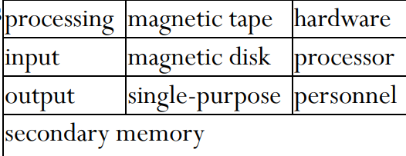
Complete the following statements with the appropriate words.
1. Information ………………… takes place in the ………………… not in the ………………… device or ………………… device.
2. The …………………refers to all the electromechanical devices used in a computer installation.
3. ………………… and ………………… units are used as ………………… storage devices.
4. A computer isn’t usually a ………………… machine and may require specialized ………………… to operate it and all its related equipment

Slide 8
Computer capabilities and limitations
Reading…

Slide 9
Decide weather the following statements are true or false.
1. A computer cannot do anything until it has been programmed.
2. A computer is a useless machine if its capabilities and limitations are unknown.
3. A computer can repeat the same operation over and over again forever if permitted.
4. The speed at which different computer components function is considered to be one of the limitations of a computer.
5. Computers do not usually make mistakes unless they break down.
6. A computer can think and solve problems by itself.
7. A computer is a single-purpose machine in that it cannot be programmed to solve various types of problems.
8. Computers can solve big problems by following a series of simple steps.
9. A computer usually solves problems by doing some mathematical and decision-making operations.
10. Computers are used because they are fast and exact

Slide 10
Synonyms & antonyms
Refer back to the text and find the synonyms.
1. job .…….……...……
2. comprehended ……………….…
3. clever .…………………
4. cases ……………….…
5. salary sheet ……………….…
Refer back to the text and find the antonyms.
1. basic ……………….…
2. exceptional .…………………
3. run well .…………………
4. slowly .…………………
5. employer .…………………

Slide 11
Choose the appropriate form of the words to complete the sentences.
1. repetition, repeat, repetitive, repeatedly, repeating
a. There are some people who ............................. arrive late to class whenever they're working on a program because they forget the time.
b. A computer can do ........................ operations without getting tired or bored.
с. .................................. which can be a boring and unproductive task has been eliminated with the use of computers.
d. A computer can .................................. the same operation over and over again accurately without becoming bored or tired.
2. comparison, compare, comparable, comparatively, comparative
a. Renting a computer isn’t .................................. to owning one.
b. Computers can .................................. numbers.
с. There is sometimes very little .................................. to be made between two different brand-name microcomputers.
d. The difference in price of microcomputers from different manufacturers can be .................................. small.

Slide 12
3. repairs, repaired, repairable, repair
a. When the computer is down it needs to be .................................. .
b. Electronic equipment often takes a long time to .................................. .
с. .................................. to a computer system are often done by the same company who manufactured the system.
4. accuracy, accurate, accurately
a. A computer is always .................................. in its results if well prepared.
b. .................................. is one of the advantages of using computers in research or in statistical analysis.
c. Computers can produce results quickly and ..................................

Slide 13
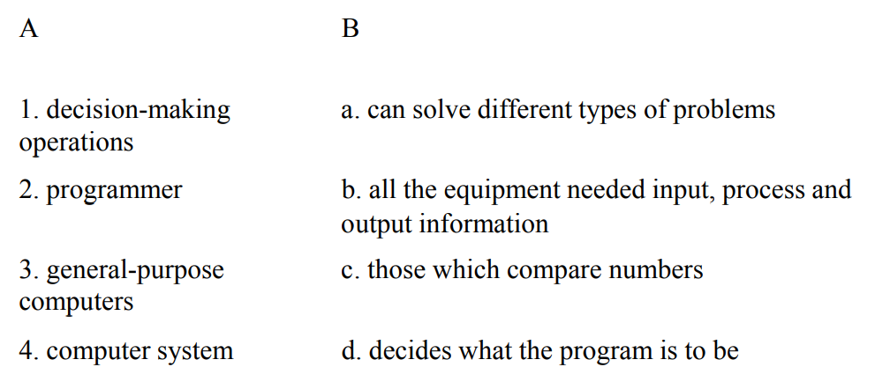
Match the following words in column A with the statements in column B.

